Slide 1
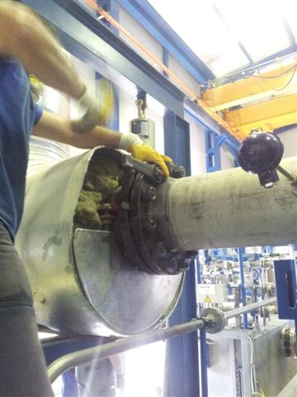
HS&E INCIDENT BULLETIN |  | 1st half year 2014
Germany | Type of incident - Slip/Trip/Fall from same level
Summary:
An employee was disassembling a turbine casing using a screw wrench. The wrench slipped off the screw, which caused the employee to step backward and twist his knee. Employee was diagnosed with a cruciate ligament rupture at the right knee; surgery followed.
Root Causes: | Actions Taken Thus Far: Next Steps
Restricted space preventing use of correct tool | Design of special HyTorc tool for this application with adapted part for restricted space.

